Slide 1


Stocks investment IN the u.s. Oil and Gas Sector
Business School
Risk Analytics
Student ID: 2031611

Slide 2
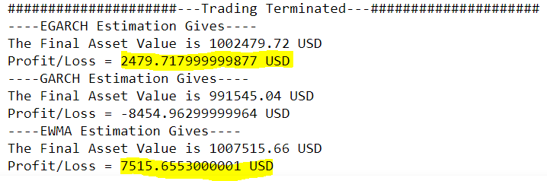
Executive Summary
1
Investment Amount: $ 1,000,000
Investment Goals: To maximise relative wealth against the MSCI ACWI Benchmark during 1 hour trading period while constraining the expected shortfall in the 1% tail within 1% of the portfolio value.
Portfolio Composition: Five least correlated stocks from the Oil, Gas & Consumable Fuels (GICS code: 101020) industry.
Trading Algorithm: The trading algorithm is forecasting the returns of MSCI ACWI Benchmark and five selected stocks, 5 minutes ahead. Then, according to investor’s risk appetite, it allocates the optimal weights to each stock that maximise the active return/relative wealth of the portfolio.
Backtesting Performance:

Slide 3
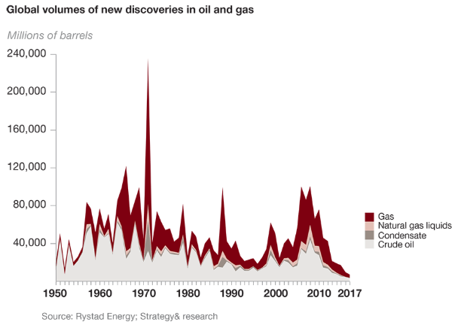
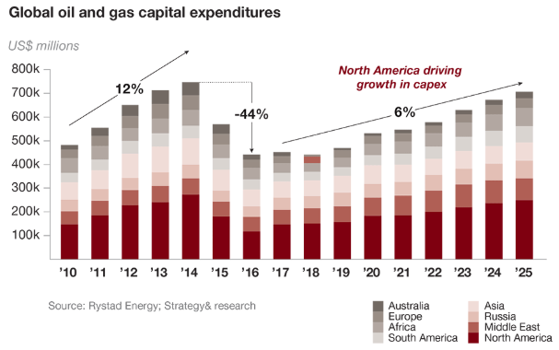
Market
2
Oil and Gas Market Overview
The Oil, Gas & Consumable Fuels industry has a revenue of $180 billion.
The U.S. Energy Information Administration (EIA) projects that the United States will export more crude oil and petroleum products combined than it imports (net exporter) until 2050, but under certain conditions, it could become a net exporter of crude oil on its own in the future as well.
The North American Oil and Gas industry is expected to be driving the global growth of 6% annually.

Slide 4
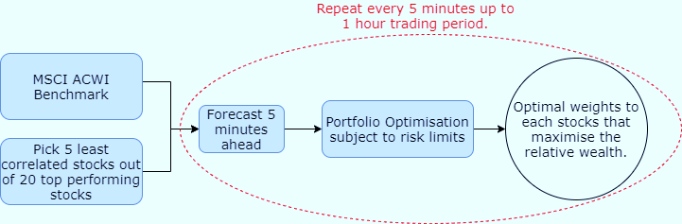
Algorithm & Customisation/Fine Tuning
3
Algorithm
Customisation
The 5 least correlated stocks out of the main 20 in the industry are selected to build the portfolio.
The evolution of risk factors throughout the investment period is modelled to predict the stock returns and get the optimal portfolio.
Value and small-cap stocks outperform markets on a regular basis. The FAMA & French model is chosen to explain returns because it considers that, value and small-cap stocks outperform markets on a regular basis. The model is able to adjust for this outperforming tendency.
3 methods are used to forecast the risk factors as way for comparing and checking the reliability of the forecast data.
The portfolio is optimised subject to the constraints of the investor’s risk preference.
Select market specific index - S&P 400 Oil, Gas & Cnsmble Fuel(Ind) index as one of the risk factors.
Select momentum index - MTUM factor index.

Slide 5
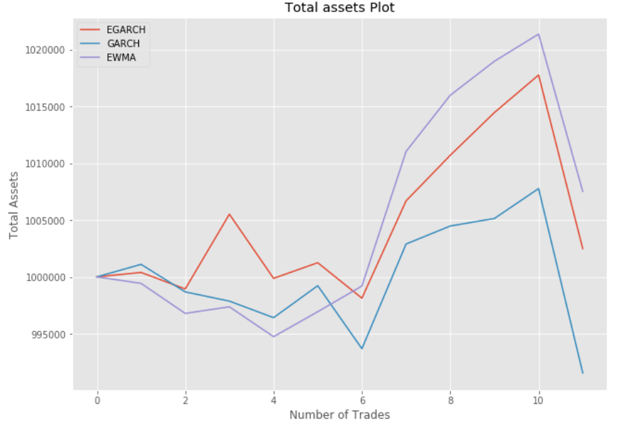
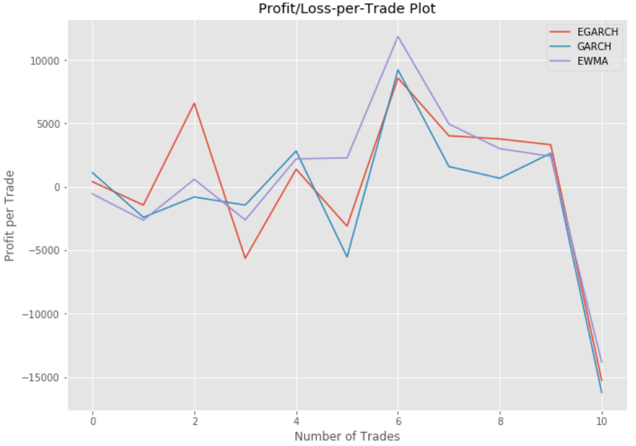
4
Performance - Backtesting

Slide 6
Conclusions
5
Improvements:
Include news scanning algorithm to capture market moving information that affects the portfolio. This is particularly useful for oil and gas industry as the global politics has a huge impact on the oil and gas industry.
Search for more risk factors that better explain the returns. Ideally, the R² of the regression should be at least 90%.
Add equity implied volatility to the portfolio if accessible from data provider. Generally, volatility has a strong negative dependence with the underlying stock price. Hence, the diversification effect of including volatility in the portfolio is attractive to many equity hedge funds (pg.296 in Alexander, C. Market Risk Analysis: Vol II).
Incorporate the Black-Litterman model so a Bayesian approach can be taken to combine the subjective views of investors, regarding the expected returns of one or more assets with the market expected returns (the prior distribution) to form a new, mixed estimate of expected returns. This would enable Macro factors to be included into the strategy. The main effect of incorporating the model would be that the algorithm would be less sensitive to historical data and more robust since active views from the manager are being taken into account.

